Slide 1
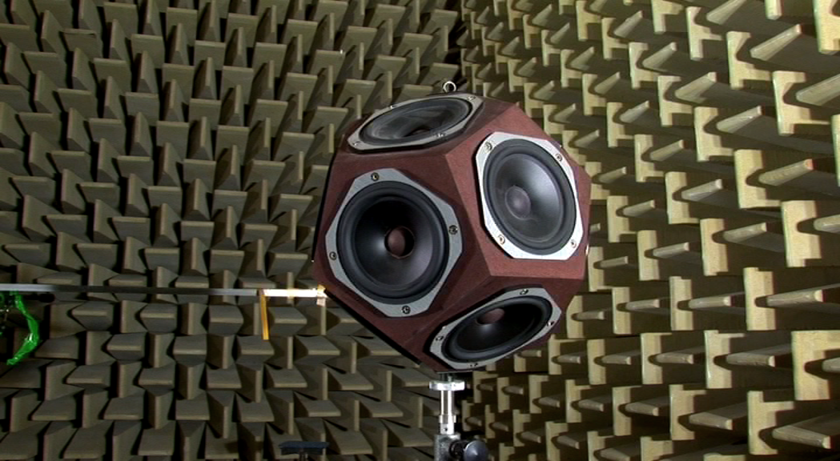
Acoustics (Part 1)

Slide 2

Contents
Acoustics and its importance
Reverberation time
Sabine’s and Eyring’s formulae (Qualitative idea)
Absorption coefficient
Method to measure absorption coefficient
Applications of acoustics- Designing of hall for speech, concert, and opera

Slide 3
Contents
Acoustics and its importance
Reverberation time
Sabine’s and Eyring’s formulae (Qualitative idea)
Absorption coefficient
Method to measure absorption coefficient
Applications of acoustics- Designing of hall for speech, concert, and opera

Slide 4
Acoustics
What is acoustics?
Derived from the Greek word ἀκουστικός (akoustikos), meaning "of or for hearing, ready to hear
Deals with the production, propagation, transmission, detection of sound waves is called acoustics.
Classification of sound:
(i) Infrasonic –below 20 Hz (Inaudible)
(ii) Audible 20 to 20,000Hz (Music and Noise)
(iii) Ultrasonic - 20,000Hz (Inaudible)

Slide 5
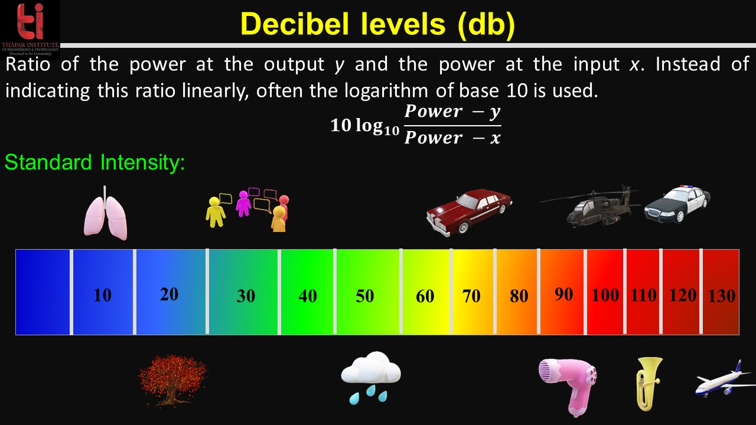


Slide 6
Acoustics: Properties
Sound is a mechanical wave and therefore requires a medium to travel.
So, It is reflected, transmitted, or absorbed by the materials it encounters.
Soft surfaces: textiles, and batt insulation, tend to absorb sound waves, preventing them from further motion.
Hard surfaces: ceramic tile, gypsum board, or wood, tend to reflect sound waves, causing ‘echo’.
Dense, massive, materials: concrete or brick, tend to transmit sound waves through the material.

Slide 7
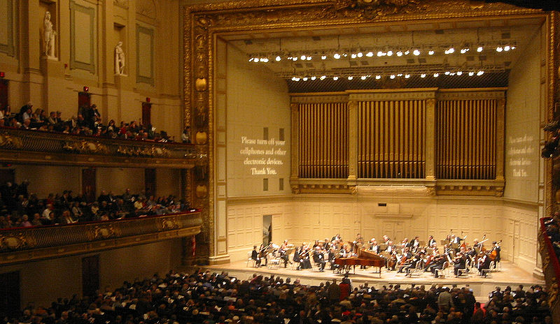
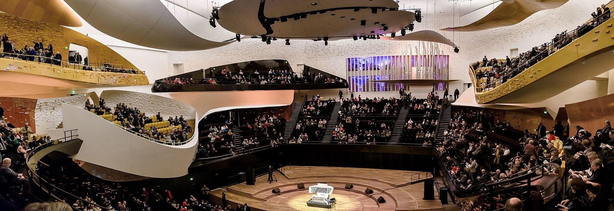
Architectural Acoustics (Acoustics of Buildings)
Deals with design and construction of hall or rooms
Hall or rooms are acoustically poor due to;
• distribution of intensity is not uniform
• different frequency of sound interfere and reduces the quality
Symphony Hall
Philharmonie de Paris

Slide 8
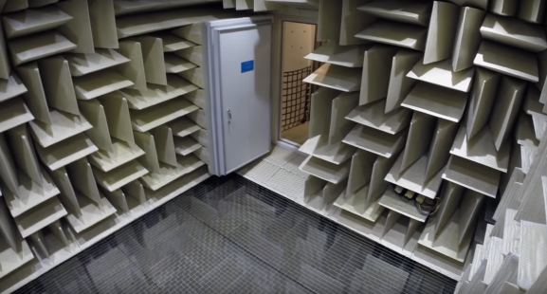
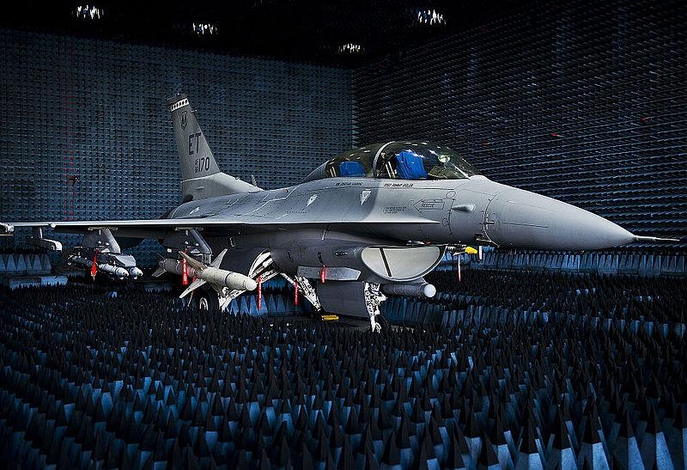
Anechoic chamber
An anechoic chamber is a space in which there are no echoes or reverberations.
The surfaces absorb all sound, and reflect none.
An anechoic chamber on the campus of Microsoft broke the world record with a measurement of −20.6 dBA - officially the quietest place on the planet Earth
Quietest place on the planet Earth

Slide 9
Acoustics of the buildings
The branch of science which deals with the planning of a building to provide the best quality audible sound to audience.
Any hall having the good acoustics should have following features:
✓ The quality of the speech/ music remains unchanged in each and every
portion of the Hall.
✓ The sound produced must be sufficiently loud.
✓ There shouldn't be any echo.
✓ The reverberation should be proper.
✓ There should not be any focusing of sound in any part of the hall.
✓ The walls should be sound proof to avoid the external noise in the hall

Slide 10
Reverberation
When a sound is produced inside a building, it expands and gets reflected from all the surfaces, viz; walls, ceiling and floor of the hall. Audience will receive a direct sound from the source followed by series of sounds reflected and traveling towards him. These successive sounds will be of diminishing intensity. Therefore listener will continue to receive the sound even after the source of sound has stopped emitting. This is called as reverberation.
The persistence or prolongation of sound in a hall even though the
sound source is stopped called Reverberation.

Slide 11
Reverberation time
The time taken by the sound wave to fall below the minimum audibility level after the source is stopped.
Or
i.e. to fall to one millionth of its initial intensity, after the source is stopped.
If Reverberation Time is too low: Sound disappear quickly and become inaudible.
If Reverberation Time is too high: Sound exist for a long period of time - an overlapping of successive sounds results in unclear information.
Therefore, for the good audibility: Reverberation time should be optimum.

Slide 12
Optimum reverberation time
Activity in Hall | Optimum Reverberation Time (Sec)
Conference halls Cinema theatre Assembly halls Public lecture halls Music concert halls Churches | 1 to 1.5 1.3 1 to 1.5 1.5 to 2 1.5 to 2 1.8 to 3

Slide 13
Acoustics (Part 2)
Sabine’s and Eyring’s formulae

Slide 14
Contents
Acoustics and its importance
Reverberation time
Sabine’s and Eyring’s formulae (Qualitative idea)
Absorption coefficient
Method to measure absorption coefficient
Applications of acoustics- Designing of hall for speech, concert, and opera

Slide 15
Sabine’s Formula for Reverberation Time
Prof. W. C. Sabine (1868-1919) determined the reverberation times of empty halls and furnished halls of different sizes and arrived at the following conclusions.
The reverberation time depends on the reflecting properties of the walls, floor and ceiling of the hall.
The reverberation time depends upon the volume of the hall.
The reverberation time depends on the absorbing power of the various surfaces (carpets, cushions, curtains etc).
The reverberation time depends on the frequency of the sound.
The reverberation time is independent of the positions of the source and the listener and the shape of the room.

Slide 16
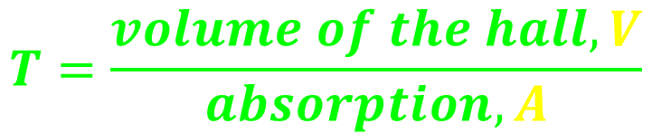
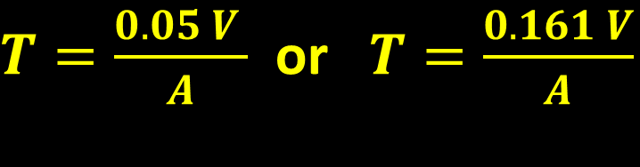
Sabine’s Formula for Reverberation Time
Prof. Sabine summarized his results in the form of the following equation.
Reverberation Time,
where K is a proportionality constant, whose value depends upon the units in which the length is measured
If it is in feet then K = 0.05 and (velocity of sound 1120 ft s⁻¹)
If it is in meter then K = 0.161 (velocity of sound 340 m s⁻¹)
This Equation is known as Sabine’s formula for reverberation time

Slide 17
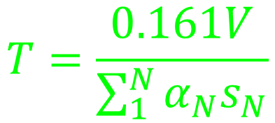
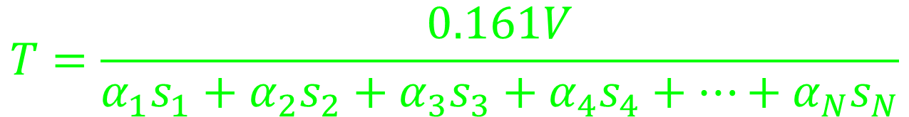
Sabine’s Law
It may be rewritten as and also called as Sabine’s Law
as V, S and α can be calculated from plans and specifications, so it is possible for an architect to design an auditorium with any desired time of reverberation

Slide 18
Absorption of sound
The property of a surface by which sound energy is converted into other form of energy (heat) is known as absorption.
1. Porosity: In the process of absorption sound energy is converted into heat due to frictional resistance inside the pores of the material. The fibrous and porous materials absorb sound energy more, than other solid materials.
2. Flexural vibration: When sound waves fall on flexible materials not rigidly mounted, the material of course is set into vibration and the damping forces called into play dissipate the incident sound energy into heat.
It is mainly due to two causes:

Slide 19
Absorption Coefficient of Sound
The coefficient of absorption `α’ of a materials is defined as the ratio of sound energy absorbed by its surface to that of the total sound energy incident on the surface.
Thus the unit of absorption is the open window unit (O.W.U.), which is named a “Sabine” after the scientist who established the unit.
1m² Sabine is the amount of sound absorbed by one square meter area of fully open window.

Slide 20

Absorption Coefficient of Sound
The value of “α” depends on the nature of the material as well as the frequency of sound. It is a common practice to use the value of “α” at 500 Hz in acoustic designs.
If a material has the value of “α” as 0.5, it means that 50% of the incident sound energy will be absorbed per unit area.
If the material has a surface area of S sq.m., then the absorption provided by that material is

Slide 21
Limitation of Sabine’s Formula
It is good for only small values of absorption coefficient (α < 0.2)
It is not valid for higher values of α
This is because for α = 1, T should be zero, where as Sabine’s formula finds T = KV/A, a non zero value.
For higher values of absorption coefficient, the Sabine’s formula gives higher value of reverberation time than its actual value.
Therefore, Eyring’s Formula came in existence

Slide 22
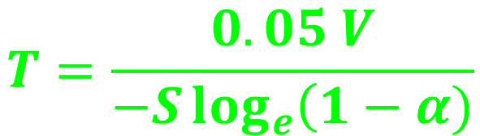
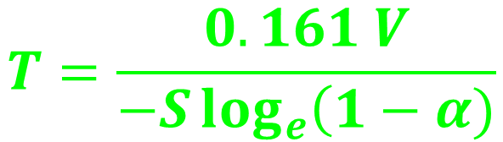
Eyring’s Formula
Under the same assumptions, as has been considered for Sabine’s case
Fraction of energy absorbed = average absorption coefficient = α, and
Fraction of energy reflected = average reflection coefficient = 1- α
(when velocity of sound is 1120 ft s⁻¹)
(when velocity of sound is 340 m s⁻¹)

Slide 23
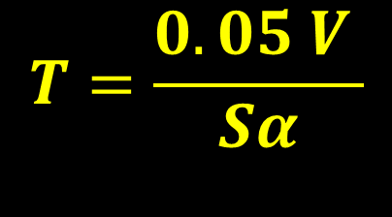
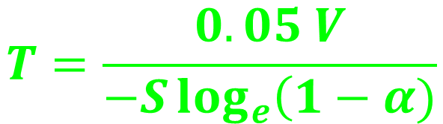
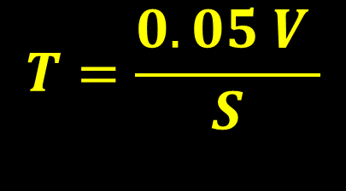
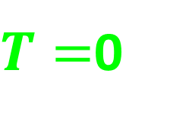
Sabine’s vs Eyring’s Formulae
Sabine’s
Eyring’s
Both formulae gave identical value when α is small
However, for large value of α, two gave different values of T
Since in this case there is no reflection of sound energy, there is no reverberation time, so Eyring’s formula gives correct results

Slide 24
Acoustics (Part 3)
Method to measure absorption coefficient and applications of acoustics

Slide 25
Contents
Acoustics and its importance
Reverberation time
Sabine’s and Eyring’s formulae (Qualitative idea)
Absorption coefficient
Method to measure absorption coefficient
Applications of acoustics- Designing of hall for speech, concert, and opera

Slide 26
Methods to measure absorption Coefficient
One can use three different ways to measure absorption coefficient of sound:
Reverberation chamber method 1
Reverberation period of room with cushions or other absorbent materials presented in hall is first measured
The cushions or other absorbent materials are then removed and the extent
of the open window is gradually adjusted until the reverberation time is the same as before.
The ratio of the area of window opened to the total area of cushions or other absorbent materials is then determined and consider as absorption coefficient of the substance.

Slide 27
Methods to measure absorption Coefficient

Slide 28
Methods to measure absorption Coefficient
Reverberation chamber method 3
The average value of the absorption coefficient of a room may be calculated
by the concept of decay of intensity.
According to which after the source of sound is switched off, the intensity I,
at t is given by,
Let two different sources of sound are placed one by one in the hall and I_{m} and I’_{m} are the maximum intensities.
Now if T₁ and T₂ be, respectively, the times for these intensities to fall to the threshold intensities of sound, then

Slide 29
Applications of acoustics- Designing of hall
Acoustically good hall means that in which every syllable or musical note reaches an audible level of loudness at every point of the hall and then quickly dies away to make the room ready for the next syllable or group of notes.
Desirable acoustics properties
Even Dispersion
A feeling of "intimacy" or musical "presence“
Good Projection of Sound
Good clarity and articulation
Long enough reverberation time but not too long
Good balance of low and high frequencies
Extraneous Noise and Sound Insulation

Slide 30
Applications of acoustics- Designing of hall
Acoustically good hall means that in which every syllable or musical note reaches an audible level of loudness at every point of the hall and then quickly dies away to make the room ready for the next syllable or group of notes.
Desirable acoustics properties
Shape and surface of the hall
Even Dispersion
A feeling of "intimacy" or musical "presence“
Good Projection of Sound
Good clarity and articulation
Long enough reverberation time but not too long
Good balance of low and high frequencies
Extraneous Noise and Sound Insulation

Slide 31
Applications of acoustics- Designing of hall
Acoustically good hall means that in which every syllable or musical note reaches an audible level of loudness at every point of the hall and then quickly dies away to make the room ready for the next syllable or group of notes.
Desirable acoustics properties
Shape and surface of the hall
Even Dispersion
A feeling of "intimacy" or musical "presence“
Good Projection of Sound
Good clarity and articulation
Long enough reverberation time but not too long
Good balance of low and high frequencies
Extraneous Noise and Sound Insulation
Control of reverberation time
Sound insulation

Slide 32
Shape of the hall
Internal shape
Surface & Ceiling
Floors

Slide 33
Shape of the hall
Internal shape
Surface & Ceiling
Floors
A rectangular shoebox-shaped concert halls with stage across one narrow end is excellent for music.
For greater seating capacity the side wall should be splayed from the stage (30 – 60° )

Slide 34
Shape of the hall
Surface & Ceiling
Avoid round walls (circular or elliptic shape) because such walls concentrate the reflected sound (like spherical mirrors) in particular areas that leads to a non-uniform sound intensity in the audience area.
Avoid strictly parallel plain walls (like those in halls of a strictly rectangular shape) because (resonance) standing waves with a highly non-uniform sound intensity (nodes and antinodes) can be formed between such walls.
Angled side walls spread the sound energy and contribute to even dispersion

Slide 35
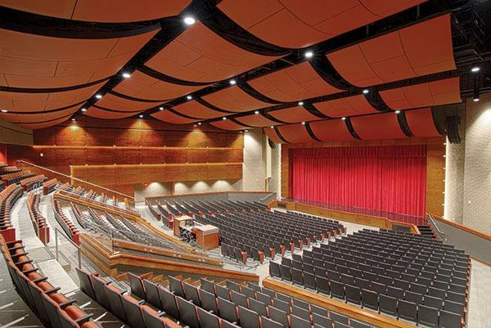
Shape of the hall
Surface & Ceiling
Ceiling reflectors/clouds are used to direct the sound energy from the stage to the seating areas
In some cases clouds are make absorptive to avoid late reflection - covering high ceiling with absorbent material – to avoid echoes

Slide 36
Shape of the hall
Floors
Sloping floor – generally the floor of an auditorium should not be less than 8°
covering floor with carpet – to avoid echelon effect

Slide 37
Controlling reverberation time
By providing windows and ventilators can be opened and closed to make the optimum time of reverberation.
Using heavy curtains with folds.
The walls are lined with absorbent material such as felt, fibre board, glass wool etc.
Having full capacity of audience.
By covering floor with carpet.
A broadcasting room should practically have no reverberation – it entirely be covered with porous materials to have almost 100% absorption.

Slide 38
Controlling reverberation time
With large absorption the time of reverberation will be smaller which will minimize the chances of confusion, and may go below the level of intelligibility of hearing. Hence, sufficient loudness in every portion of the hall is an important factor for satisfactory hearing. The loudness can be maintained at desired level by:
Using large sounding boards behind the speaker and facing the audience
Large polished wooden reflecting surfaces immediately above the speakers.
Low ceiling are also useful in reflecting the sound energy towards the audience.
By providing additional sound energy using more number of speakers.

Slide 39
Extraneous Noise and Sound Insulation
avoiding openings for pipes and ventilators.
allotting suitable locations for doors and windows .
using heavy glasses to doors and windows.
by providing double wall construction with air space between them.
by interposing layers of some acoustical insulators.
use of soft floor finish e.g. carpet, rubber etc.
insulating machines like refrigerators, lifts, typewriters, projector etc.
constructing small sound proof cabin for machine and office staff.
making hall sound proof

